Slide 1
The Byzantine Empire

Slide 2
What Is our Focus?
Essential Questions
How can religion impact a culture?
What factors lead to the rise and fall of empires?
We’ve already talked about the importance of maintenance and wise decisions.
It Matters Because…
In the 4th century, a separation between the western and eastern parts of the Roman Empire began to develop. While Germanic tribes were taking over western Rome and creating a new European civilization, the Eastern Roman Empire, with Constantinople as its capital, continued to exist and develop into a new empire.

Slide 3
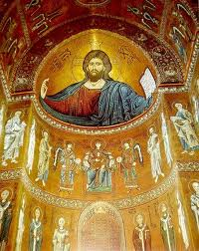
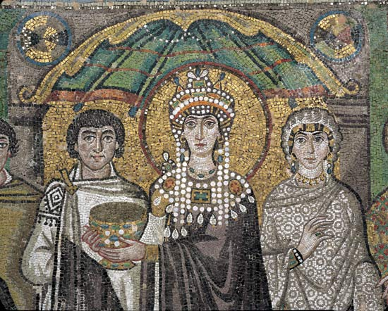
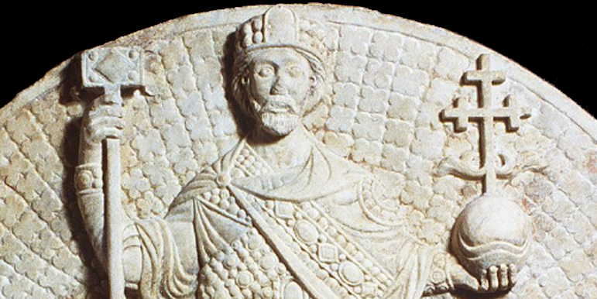
The Byzantine Empire
As the Eastern Roman Empire became smaller in size, it became its own civilization with its own unique character.
Renamed the Byzantine Empire
Would last for another 1,000 years after the fall of western Rome.
Both a Greek & Christian state.
Latin was spoken less and less, and Greek became the official language.
All citizens were profound Christians who spent enormous amounts of money and talent to honor their faith.

Slide 4
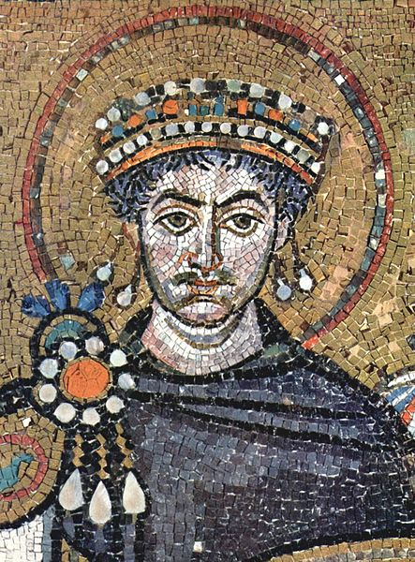
Emperor Justinian I
Emperor from
527 AD - 565 AD
Goal: To take back the old western Roman Empire and restore Roman dominance.
Significance: He wanted a rewrite of Roman Law so everything was uniform and clearly understood.
Issued in 529 AD.
“The Body of Civil Law”
Legacy
Byzantine culture spread.
Religious practice increased.
Considered a saint among some Orthodox Christians.
Emperor Justinian I

Slide 5
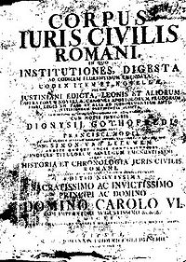
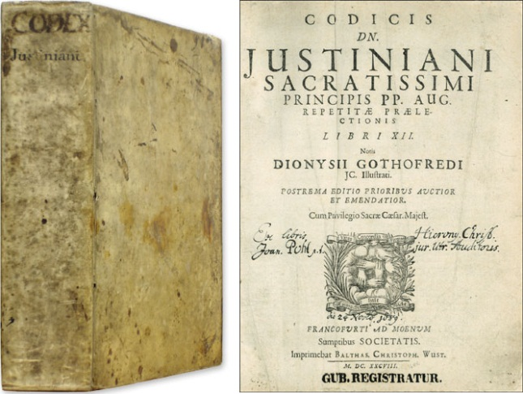
Justinian’s Code
Became the basis for many European codes of law.
Protected women from prostitution exploitation.
Rapists were severely tortured or killed.
If a woman were widowed her dowry would be returned to her.
Religious Law
All people had to observe the Christian religion.
Anyone who does not claim Christianity is not a citizen.

Slide 6
Justinian’s Code
“The maxims of law are these: to live honestly, to hurt no one, to give every one his due.”
The Institutes of Justinian, 527 AD -565 AD
Analyzing Primary Sources
How do these maxims compare with the rule of law in the modern United States?
Write your thoughts on your paper. Switch with a partner. Now write a response to your partner’s thoughts below their thoughts.

Slide 7
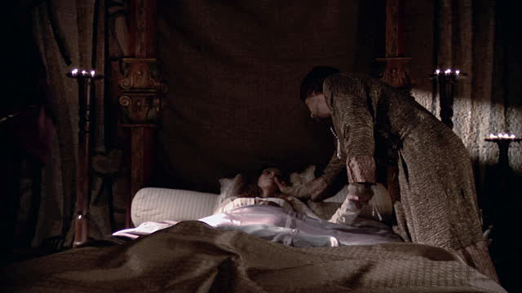
Problems & Struggles
Although Justinian’s accomplishments were spectacular, the Eastern Roman Empire still had to face serious problems:
Too much territory to protect
An empty treasury (not enough money)
Decline in population after a plague
(that almost killed Emperor Justinian)
Threats to the borders from Persians and Slavs.
600s – threats from Arabic tribes under the religion of Islam.

Slide 8
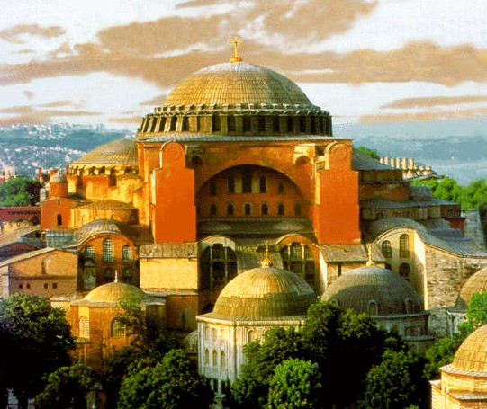
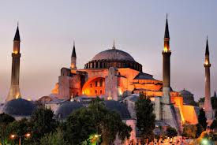
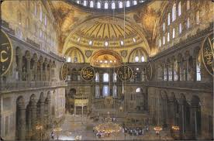
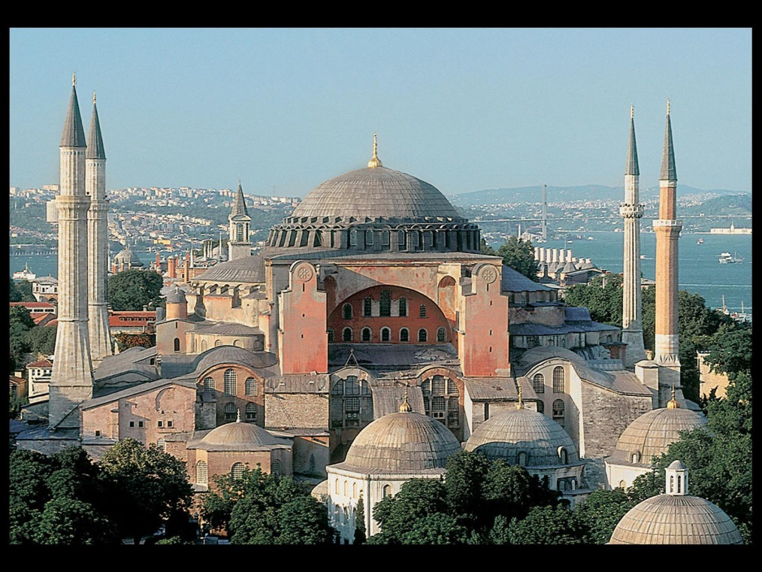
The Hagia Sophia

Slide 9
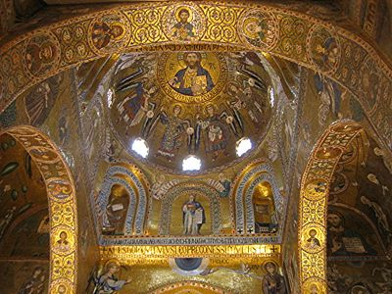
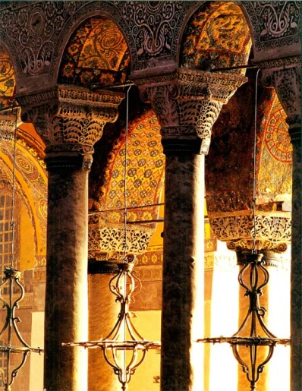
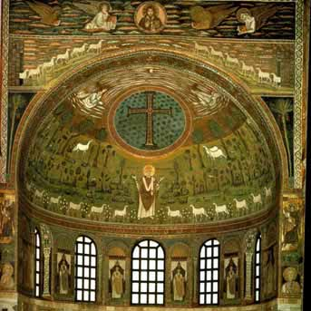

Slide 10
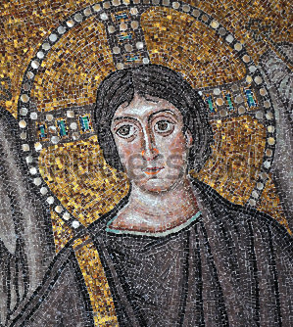
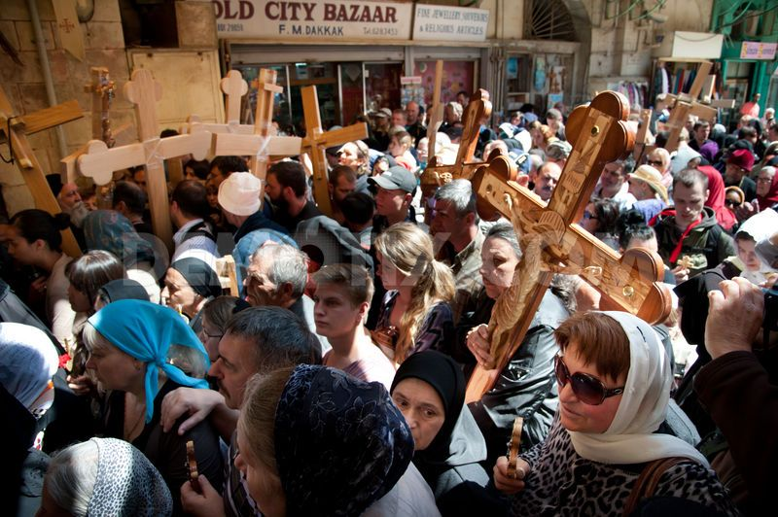
The Byzantine Empire
The emperor was known as a patriarch – leader of the government and the church.
Byzantines believed that God had commanded them to preserve a true Christian faith.
Byzantine mosaic of Jesus Christ without beard and having a youthful look.

Slide 11
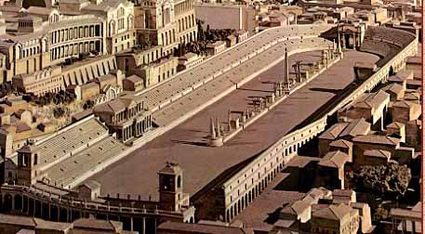
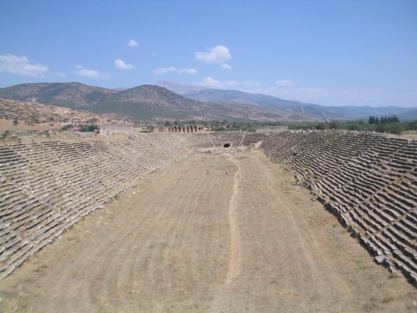
The Byzantine Empire
Justinian instituted programs of rebuilding in the 500s.
Palace complex
The Hagia Sophia
The Hippodrome
Chariot races, games, plays
Roads, Bridges, Public baths, Law courts, Schools, Churches, and Underground water supply
What’s actually left of
the Hippodrome
Computer recreation of Hippodrome

Slide 12
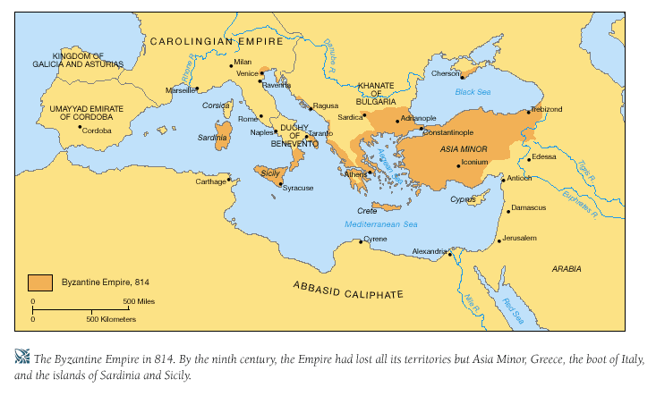
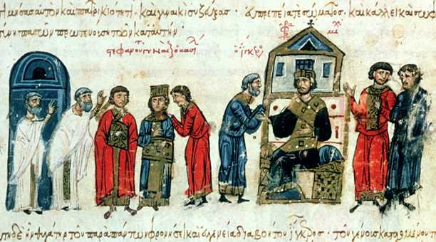
New Heights and New Problems
By 750 AD the Byzantine Empire consisted only of Turkey, the Balkans, and coastal Italy.
The Byzantines will recover and expand due to the efforts of new rulers known as the Macedonians.
Remember, Macedonia is north of Greece.

Slide 13
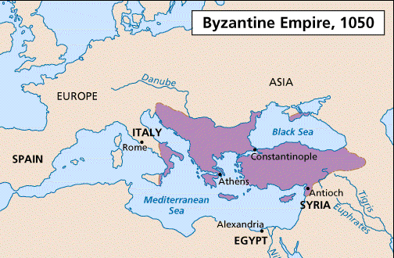
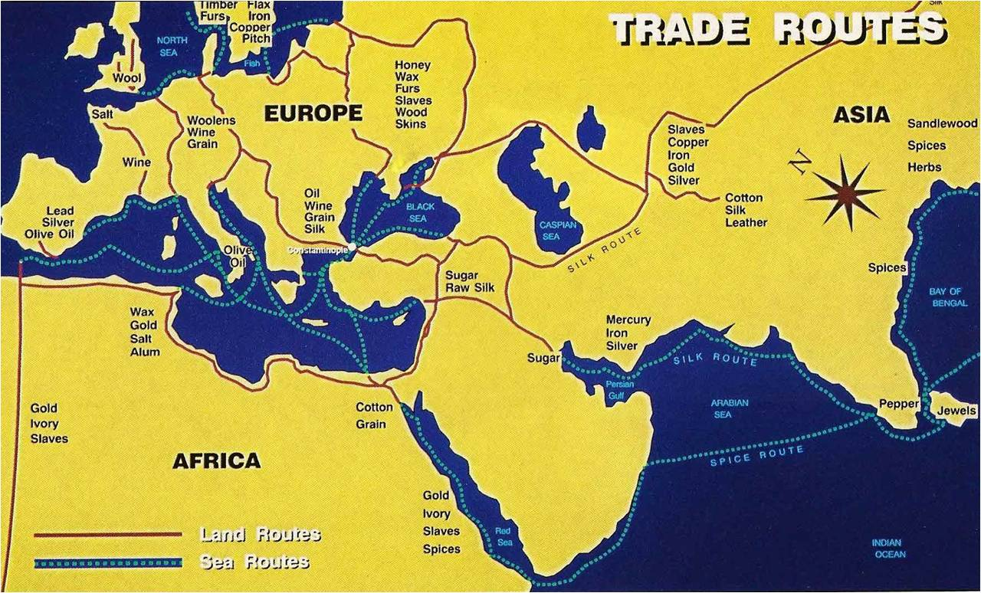
New Heights and New Problems
Macedonian Emperors
These emperors ruled from 867 – 1081.
Beat away the enemies and began to take land.
By 1025 the Byzantine Empire was the largest it had been in a very long time.
Expanded trade with western Europe by selling silks (from China) and metal works.

Slide 14
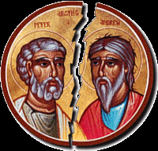
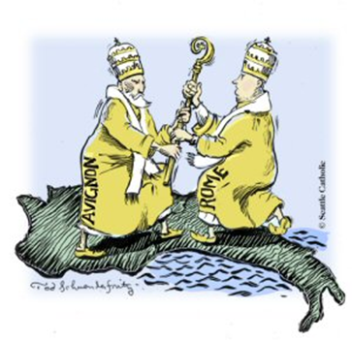
Schism in the Faith
https://www.youtube.com/watch?v=rQj0HpMdw74
Schism: Split/Separate/Divide
The Great Schism of 1054!
What happened?
Pope Leo IX (Roman) claimed he was the sole head of the Christian Church.
Patriarch Michael Cerularius (Byzantine) refused to accept that claim.
The two excommunicated (kicked out) each other from their churches.
Now there were two churches – The Roman Catholic Church, and the Eastern Orthodox Church.

Slide 15
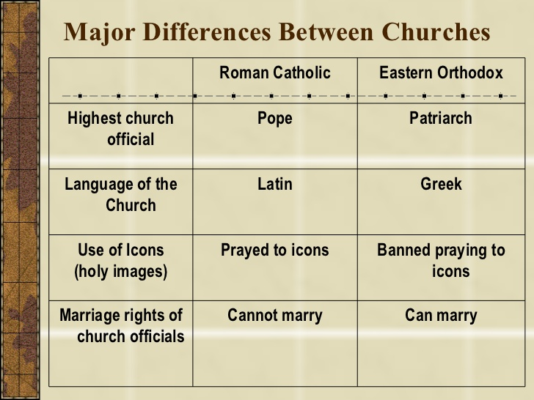
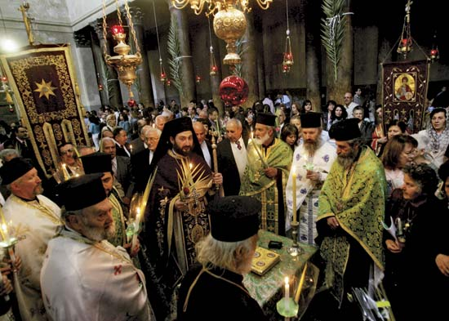
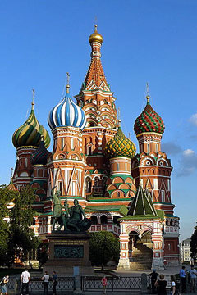
Schism in the Faith
Differences
The Patriarch in Constantinople does not have the same power and authority as the Pope in Rome.
Strong devotion to iconography (making beautiful recreations, icons, and images) created a distinctive artistic character different from Rome.
Most Orthodox Christians live in Eastern Europe, Russia, and the Middle East.
Ceremony in Greece
Russian Orthodox Church

Slide 16
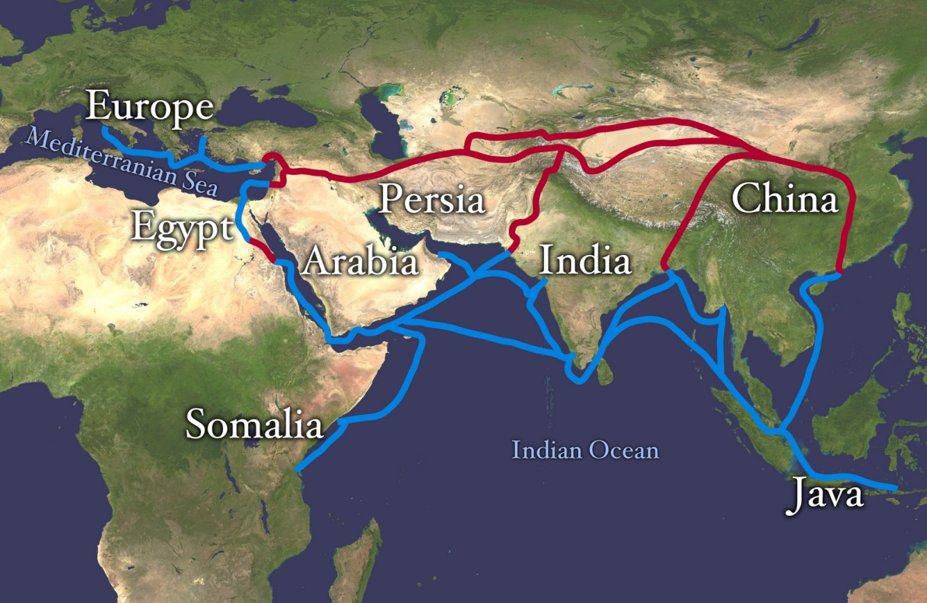
The Byzantine Empire
How It Grew
Why It Survived – Their Motto
Strong emperors
Taxes supported a large army
The crossroads of
trade between Europe
and Asia.
One God
One Empire
One Religion

Slide 17
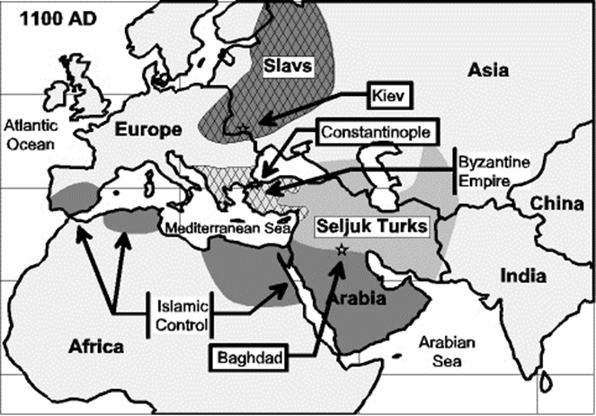
Dangers and Threats
Based on the map, what might be some problems facing the Byzantine Empire in
1100 AD?

Slide 18
Dangers and Threats
Invaders:
War with Slavs in the north
Spread of Islam in south
War with the Seljuk Turks from the east
Eventually Emperor Alexus I will ask for help from Europe for protection.
This will bring the Byzantine Empire into the Holy Crusades, which will help bring about the final downfall of the Byzantine Empire.

